Slide 1
FLIGHT BOOKING SYSTEM
PRANAV.R:-240701394
M.ASHWIN:-240701063

Slide 2
ABSTRACT
In today’s fast-paced world, air travel has become an essential mode of transportation, demanding efficient and reliable booking systems. Although there are several large-scale online platforms available for flight reservations, many local travel agencies and customers face challenges in accessing a simple and organized system. To overcome this limitation, our team has developed a Flight Booking System that enables users to book, manage, and track flight details easily.
The main objective of this project is to automate the flight booking process and provide a user-friendly interface for both administrators and customers. The system maintains complete records of flights, passengers, and ticket availability using a structured database. This not only minimizes manual errors but also saves time and enhances efficiency in managing reservations. By implementing this system, local travel operators can deliver fast, accurate, and reliable services, ensuring customer satisfaction and improved operational management.

Slide 3
INTRODUCTION
In the present era, technology has transformed the way people plan and manage their travel. Air transportation, being one of the most preferred means of travel, requires an efficient and organized system for booking and managing flights. Traditionally, flight booking was carried out manually through travel agents, which often led to errors, delays, and inconvenience for customers. With the increasing demand for faster and more reliable services, the need for an automated flight booking system has become essential.
The Flight Booking System project is designed to simplify the process of booking and managing flight details for both customers and administrators. It provides an interactive platform where users can register, search for available flights, book tickets, and view their booking details with ease. The system also allows administrators to manage flight schedules, monitor seat availability, and update necessary information in real time.
This project uses Java as the front-end programming language and MySQL as the back-end database to ensure data consistency, reliability, and security. By integrating these technologies, the system ensures a smooth flow of information and effective coordination between users and the database. Overall, the Flight Booking System aims to provide a faster, more accurate, and user-friendly solution to streamline flight management operations and enhance customer satisfaction.

Slide 4
EXISTING SYSTEM
In the existing system, flight bookings are generally managed either through manual processes or with the help of third-party online platforms. Many local travel agencies still rely on outdated methods such as maintaining records in spreadsheets, registers, or basic software applications that lack integration and automation. This manual approach often leads to data redundancy, errors in ticket booking, difficulty in tracking flight availability, and delays in updating information.
Customers, on the other hand, face challenges such as limited access to real-time flight details, unavailability of instant booking confirmation, and the need to visit agencies physically or contact them via phone for reservations. Additionally, existing large-scale online systems like global flight aggregators charge high service fees, making them less feasible for local markets or smaller agencies.
Due to these limitations, the current system fails to provide a seamless and efficient booking experience. There is a clear need for an automated, database-driven application that can handle bookings, cancellations, and customer details efficiently while maintaining data accuracy and providing real-time availability updates. The Flight Booking System aims to overcome these drawbacks by introducing a centralized and user-friendly digital solution for flight management.

Slide 5
PROPOSED SYSTEM
The proposed Flight Booking System is designed to overcome the limitations of the existing manual and partially automated systems by providing a centralized, efficient, and user-friendly platform for managing flight bookings. This system enables customers to easily register, view available flights, book tickets, and check booking details online without any manual intervention. It also allows administrators to manage flight schedules, update flight details, and monitor seat availability in real time.
The system uses Java as the front-end technology and MySQL as the back-end database to ensure secure data storage and easy retrieval. Through an intuitive interface, both users and administrators can interact with the system efficiently. The use of a relational database helps in maintaining consistency, accuracy, and integrity of flight and passenger data.
By automating the booking process, the proposed system minimizes human errors, reduces paperwork, and saves time for both customers and agencies. It provides instant booking confirmation, improves customer satisfaction, and ensures that the overall management of flight information becomes more transparent and reliable. In the long term, this system can also be expanded to include advanced features such as online payment integration, e-ticket generation, and real-time flight status updates to further enhance its functionality and usability.

Slide 6
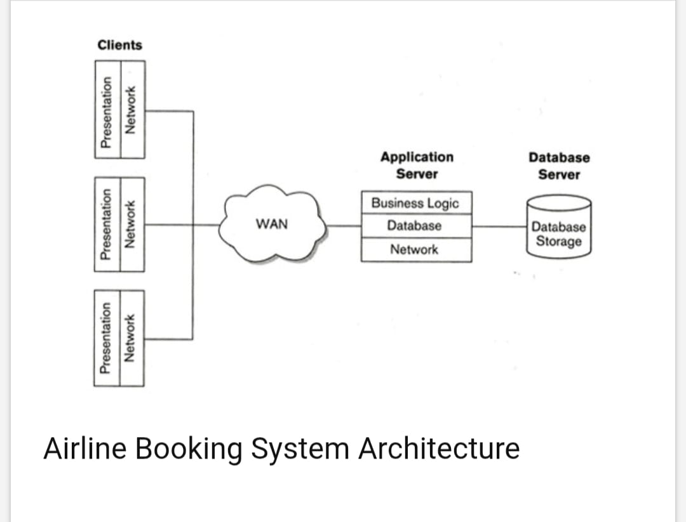
ARCHITECTURE DIAGRAM

Slide 7
TECHNOLOGY
Technologies Used
Front-End Technology – Java The system interface is developed using Java, providing a robust, platform-independent, and user-friendly environment. Java’s Object-Oriented Programming features make it ideal for handling multiple modules such as user registration, booking, and flight management.
Back-End Technology – MySQL MySQL is used as the database management system to store and manage all data related to flights, customers, and bookings. It ensures data integrity, security, and efficient retrieval through structured query language (SQL).
Database Connectivity – JDBC (Java Database Connectivity) JDBC acts as a bridge between the Java application and the MySQL database. It enables data manipulation operations such as insert, update, delete, and retrieve, allowing smooth communication between the front-end and back-end.
Development Environment – NetBeans / Eclipse IDE These Integrated Development Environments (IDEs) are used to write, compile, debug, and test the Java code efficiently, ensuring better code organization and faster development.
Operating System – Windows / Linux The system can be implemented on any operating system that supports Java and MySQL, ensuring cross-platform compatibility.

Slide 8
ALGORITHM
Algorithms Used
Login Authentication Algorithm
Validates the username and password entered by the user.
Retrieves user credentials from the database.
Grants or denies access based on matching records.
Flight Search Algorithm
Accepts inputs such as source, destination, and travel date.
Executes an SQL query to filter available flights matching user criteria.
Displays the list of flights with available seats.
Booking Algorithm
Generates a unique booking ID for every new reservation.
Checks seat availability before confirming the booking.
Updates the flight seat count and stores booking details in the database.
Cancellation Algorithm
Identifies booking details using the booking ID.
Updates seat availability in the respective flight record.
Removes or marks the booking record as canceled.
Data Retrieval and Update Algorithm
Fetches real-time flight and booking information for display.
Ensures synchronization between user actions and database updates.

Slide 9
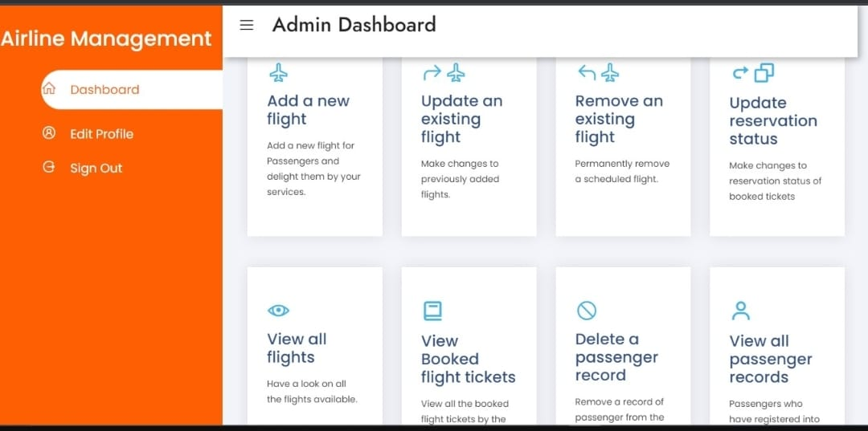
OUTPUT WITH SCREENSHOTS

Slide 10
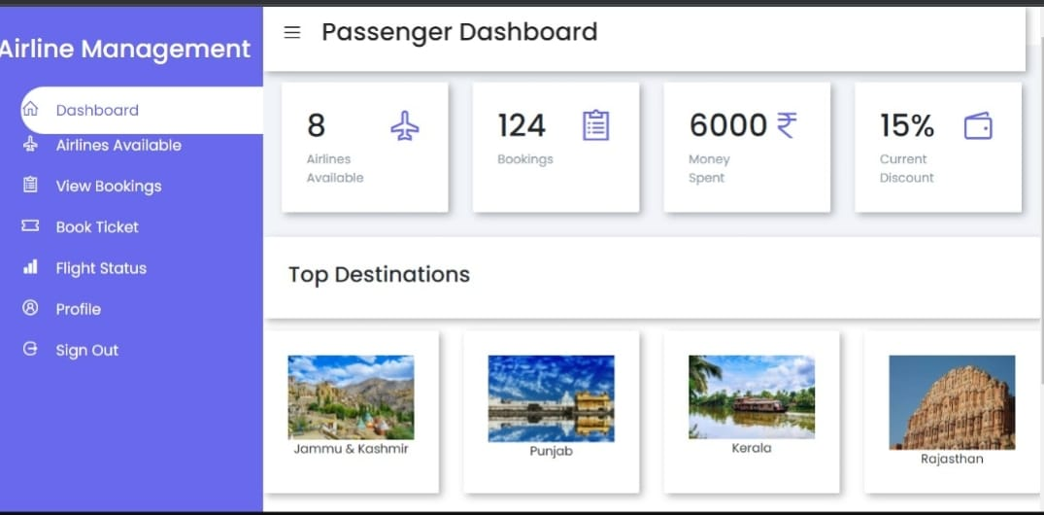

Slide 11
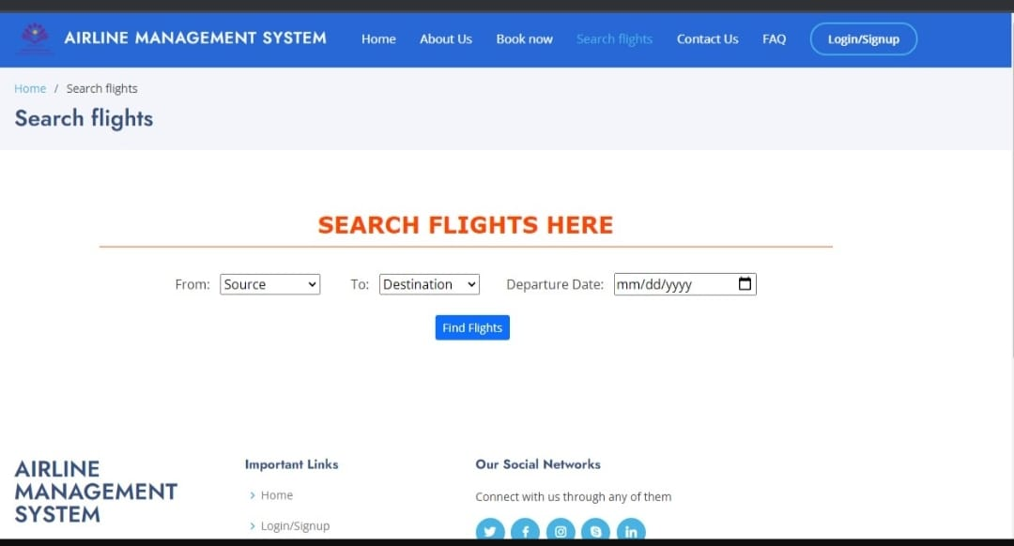

Slide 12
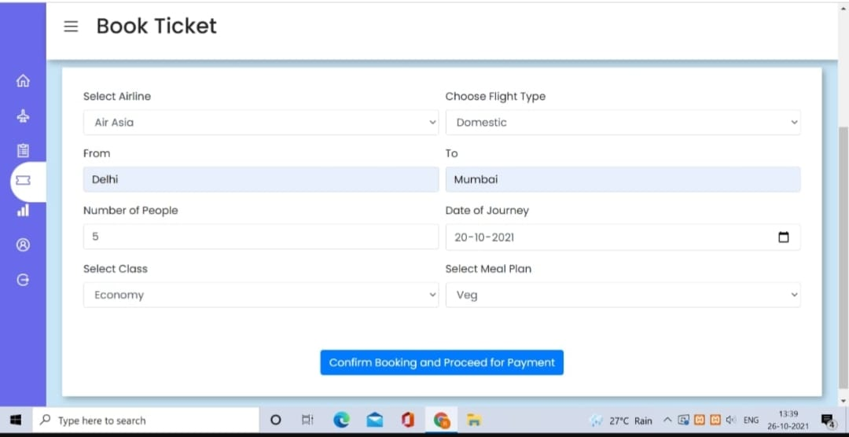

Slide 13
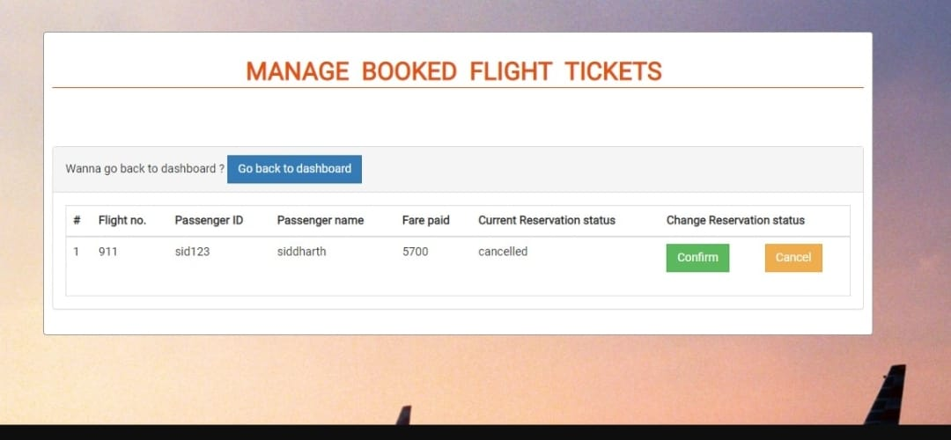

Slide 14
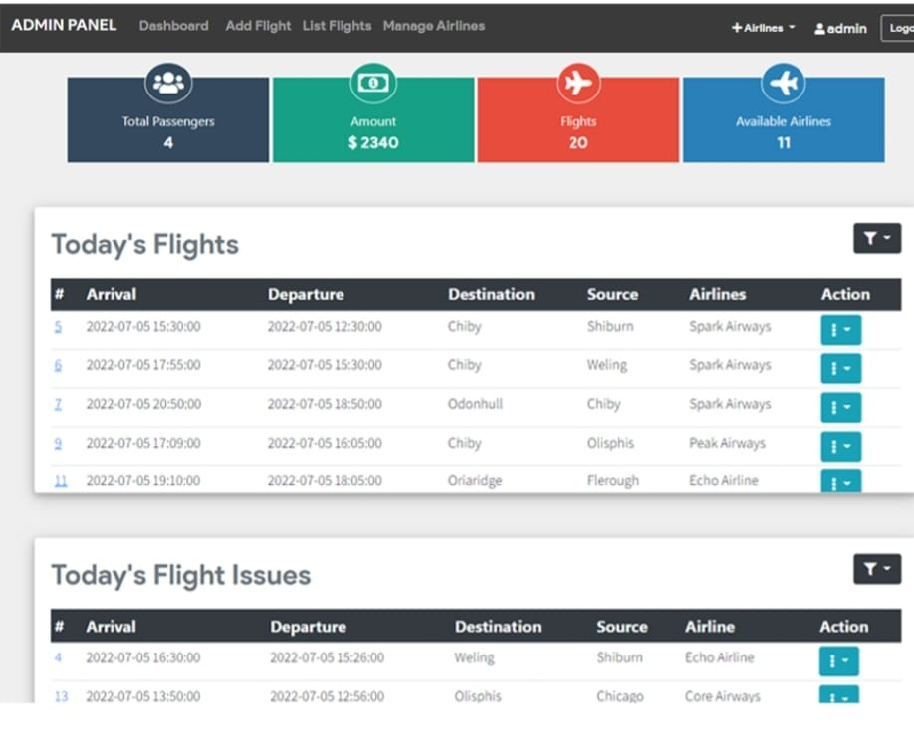

Slide 15
CONCLUSION
In such a way, with the help of our Flight Booking System project, customers will be able to easily check available flights, view schedules, and register themselves to book tickets conveniently. The system efficiently manages all data related to flights, customers, and bookings, ensuring accuracy and easy access through a centralized database. It simplifies the entire process of flight management, from searching for flights to confirming reservations, thereby saving time and reducing manual effort.
The system also provides administrators with complete control over flight details, seat availability, and booking records, enabling them to monitor and manage operations effectively. In the future, the system can be enhanced by integrating additional features such as online payments, e-ticket generation, cancellation tracking, and real-time flight status updates.
Hence, this project benefits both users and airline agencies by providing an efficient, reliable, and user-friendly solution for flight booking and management, ensuring better service and customer satisfaction in all possible ways.

Slide 16
REFERENCES
Oracle MySQL Documentation – MySQL Database Reference Manual https://dev.mysql.com/doc/
Java Tutorials by Oracle – Official Java Programming Guide https://docs.oracle.com/javase/tutorial/
W3Schools – JDBC and Database Connectivity in Java https://www.w3schools.com/java/java_mysql.asp
GeeksforGeeks – Flight Reservation System Project in Java https://www.geeksforgeeks.org/
JavaTpoint – Java Database Connectivity (JDBC) and CRUD Operations https://www.javatpoint.com/java-jdbc
TutorialsPoint – Software Engineering Project Design and Implementation https://www.tutorialspoint.com/software_engineering/index.htm

